Slide 1

Unit 14

Slide 2
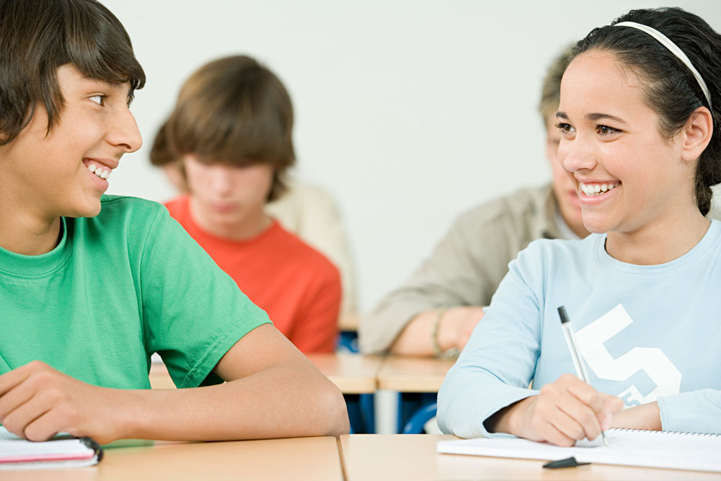
Unit 14
I remember meeting
all of you in Grade 7.

Slide 3



Slide 4


1. To review.
Simple Past Tense
Simple Future Tense
Present Perfect Tense
2. To review Objective Clause.

Slide 5


Translation.
1. 在七年级发生了什么特别的事?
______ _________ in Grade 7 that was special?
我们队赢得了学校的篮球比赛。
_________________________________
_________________________________.
What happened
Our team won the school basketball competition

Slide 6
2. 自你开始读初中以来，你有怎样的变化？
How _____ you ________ since you started junior high school?
我更擅长说英语了。
________________________________
________________________________
have changed
I’ve become much better at speaking English.

Slide 7
3. 你认为高中会有什么不同？
How do you think things ____ ___ ________ in senior high school?
我认为我会更加努力为考试作准备。
I think that I’ll have to _____ _____ ______ for exams.
will be
different
study much
harder

Slide 8
4. 明年你有什么计划？
_____ ____ _____ ______ for next year?
我要参加学校排球队。
I’m _____ ___ _____ the school volleyball team.
5. 你记得八年级的事情吗？
What do you remember about Grade 8?
我记得当过志愿者。
I remember _____ ___ ________.
What are your plans
going to join
being a volunteer

Slide 9
6. 什么事你过去常做但是现在不做了？
What ___ ___ ___ ___ ___ that you don’t do now?
我过去常上舞蹈课，但是现在不了。
I used to ____ _____ ______, but I don’t anymore.
did you use to do
take dance lessons

Slide 10
7. 你在期待什么？
What are you _______ _______ ___?
我很期待进入高中。
I’m looking forward to going to senior high school.
looking forward to
adj.级别（或地位）高的
高中

Slide 11


Slide 12

一般过去时
用法：表示过去某一时间或某一段时间内发生的动作或存在的状态，也可以表示过去经常或反复发生的动作。
谓语部分要用动词的过去式。
标志性词汇：yesterday, the day before yesterday, …ago, …later, just now, at that moment, last…, in 2001, in the past, every day last year等。

Slide 13
一般将来时
用法：表示将来某个时间要发生的动作或存在的状态，或将来经常或反复发生的动作。
构成：will / shall + 动词原形(注意：主语为第一人称时使用shall)
标志性词汇：tomorrow, the day after tomorrow, next…, in five days, in the future, later on, soon, right now等。
“be going to + 动词原形”也可以表示将要发生的动作或打算、计划、决定要做的事。

Slide 14
现在进行时
用法：表示现在(说话瞬间)正在进行或发生的动作，也可表示当前一段时间内的活动或现阶段正在进行的动作。
构成：be (am / is / are)+动词的-ing形式。
标志性词汇：now, right now, look, listen等。

Slide 15
现在完成时
用法：表示过去发生或者未发生的事对现在造成的影响或结果。
构成：主语 + have / has + 过去分词
标志性词汇：just, ever, never, yet, already, for, since, so far, recently, twice, three times等。

Slide 16
宾语从句
用作宾语的从句叫做宾语从句。
e.g. Sally always complains (that) she has too much work to do.
Could you please tell me when I can get my report card?
I want to know if our new classmate is from Japan.

Slide 17
连接词
从句来源 | 连接词 | 备注
陈述句 | that | 口语或非正式文体中常省略
一般疑问句 | if / whether
特殊疑问句 | 连接代词：who; whom; whose; which; what 等 | 在句中担任主、宾、定或表语。
 | 连接副词：when; where; why; how等 | 在句中担任状语

Slide 18
语序
宾语从句用陈述语序。如：
He is an honest boy. The teacher said.
→The teacher said (that) he was an
honest boy.
Does he work hard? I wonder.
→I wonder if/whether he works hard.
When did he leave? I don’t know.
→I don’t know when he left.

Slide 19
时态
主句是现在的时态，从句的时态可根据实际情况而定。如：
I hear that she has written three letters to the headmaster.
Mr. Green says that the snow was very heavy last month.

Slide 20
主句是过去的某种时态，从句一定要
用过去的某种时态。 如：
We didn’t know why she had missed the flight.
He told me that he was watching a cartoon film at 10 o’clock this morning.

Slide 21
【注意】
如果宾语从句表述的是客观真理、自然现象等时，从句都要用一般现在时。如：
He said that light travels much faster than sound.

Slide 22
【语境应用】将句子合并成宾语从句。
1. She bought a new camera yesterday. Li Fang said.
2. Writing is as important as speaking. I think.
Li Fang said (that) she bought a new camera yesterday.
I think (that) writing is as important as speaking.

Slide 23
3. Taiyuan is the capital city of Shanxi Province. The teacher told us.
4. You can speak French well. I believe.
The teacher told us (that) Taiyuan is the capital city of Shanxi Province.
I believe (that) you can speak French well.

Slide 24


单项选择
1. —Wendy, how long have you had the Huawei
P30 Pro?
—A couple of days. I _______ it last week.
A. bought B. buy
C. will buy D. have bought
(2019 江苏南京)

Slide 25
2. Be quiet! The students _______ an English
exam.
A. take B. are taking C. will take
(2019 四川成都)
3. —I’ve never seen Mr. Taylor before.
—Don’t worry. I _______ him to you before
the meeting.
A. will introduce B. introduced
C. have introduced D. had introduced
(2019 江西)

Slide 26
4. —What is your plan for next weekend,
Lingling?
—I _______ volunteer work in the museum.
A. was doing B. did
C. have done D. am going to do
(2019 天津)

Slide 27
5. My father _______ in a panda protection
center for 10 years, so he knows a lot about
pandas.
A. was working B. is working
C. has worked D. will work
(2019 广东)

Slide 28
6. It _______. Please take an umbrella with
you, Annie.
A. rains B. is raining
C. rained D. was raining
(2019 河北)
7. —I am worried about _______ I can enter a
good high school or not.
—Take it easy. Believe in yourself!
A. that B. when C. whether D. where
(2019 湖北咸宁)

Slide 29
8. We don’t know _______, but it tells us the
importance of friendship.
A. what the story is about
B. whether the story is true
C. when did the story take place
(2019 福建)

Slide 30
9. —Could you tell me _______ for the fruit?
—By paying over the Internet.
how much will I pay
B. how much I will pay
C. how will I pay
D. how I will pay
(2019 天津)

Slide 31
10. —Did you notice _______ in her office?
—Yes. She was going over our writing.
A. what was Miss Lin doing
B. what Miss Lin was doing
C. what does Miss Lin do
D. what Miss Lin does
(2019 北京)

Slide 32
11. —Dear friends, do you still remember
_______ three years ago?
—To realize our dreams!
A. why you came here
B. why did you come here
C. how you came here
D. how did you come here
(2019 重庆A卷)

Slide 33
12. —Have you decided _______ the Expo
2019 Beijing?
—This summer holiday.
A. how are you going to
B. how you are going to
C. when are you going to
D. when you are going to
(2019 广东)

Slide 34



4a
Number the sentences to make
a paragraph.

Slide 35
_____ When I get to senior high, I will join the school
swim team.
_____ My time in junior high school has been enjoyable.
_____ In Grade 8, I studied harder but I still got poor
grades in English. I had problems with
pronunciation and reading texts. So the next year,
I worked much harder and got better grades.
_____ Next year, I will be in senior high school. I can’t
believe how fast the time went by!
_____ This year, with Mr. Trent’s help, my English
level has been improving and I hope to get good
grades at the end of the year.
_____ In the first year, I didn’t work very hard in class, but I joined many different school clubs and had a lot of fun.
6
1
3
n.课文；文本
5
(时间)逝去；过去
4
n.水平
2

Slide 36
Read the passage and write the timeline.
My time in junior high school (general introduction)
In the first year (Grade 7)
In Grade 8
This year (Grade 9)
Next year
When I get to senior high

Slide 37
4b
Write your own answers to the
questions.
1. What do you remember about Grade 7?
2.What happened in Grade 8 that was special?
I remember losing my schoolbag in Grade 7.
My P.E. teacher Mr. Lu was kind when I hurt my knee. He told me to take a break for running.

Slide 38
3. What did you use to do that you don’t do now?
4. How have you changed since you started junior high school?
I used to be afraid of giving a speech in public, but now I don’t.
Open.

Slide 39
5. How do you think things will be different in senior high school?
6. What are your plans for next year?
7. What are you looking forward to?

Slide 40


senior high (school) 高中
go by (时间)逝去；过去
with sb.’s help 在某人的帮助下
look forward to 盼望；期待

Slide 41


Ⅲ. 根据短文内容及括号内所给词语的提示，用
正确的时态补全短文，使短文完整、通顺。
Hi Amelia,
How are you? I haven't heard from you for a while, so I thought I'd drop you a line (给你写
信). How are you all?
We've just come back from a holiday in the Alps.

Slide 42
It was wonderful! We (1)__________(see) some fantastic mountain scenery (风景) every day, and (2)__________(swim) in some beautiful and cold lakes. Even the kids (3)__________ (enjoy) all the walking! I thought they would complain (抱怨). We've decided to go again next year.
How are your kids? Has Alice started school yet? Does she like it? And what about Jason?
saw
swam
enjoyed

Slide 43
Has he scored any goals for his football team lately? I (4)________________(never forget) the last time we (5)__________(watch) him in a match. He played brilliantly! I'm sure he (6)__________(be) a professional footballer.
Write soon! Even better, come and visit us, because we haven't seen each other for such a long time!
Love,
Joanna
will never forget
watched
will be

Slide 44


1. Review Grammar and write your own
answers of the exercise 4b.
2. Preview 1a-2a on page 109.

Slide 45


